Slide 1

Contrastive Adaptation Network for Unsupervised Domain Adaptation URL : https://paperswithcode.com/paper/contrastive-adaptation-network-for
Kang, Guoliang; Jiang, Lu; Yang, Yi; Hauptmann, Alexander G
Presented By : David Ishak Kosasih

Slide 2
Outline
Introduction
Methodology
2.1 Maximum Mean Discrepancy Revisit
2.2 Contrastive Domain Discrepancy
2.3 Contrastive Adaptation Network
2.4 Optimizing CAN
Experiments
3.1 Setups
3.2 Comparison with the state-of-the-art
3.3 Ablation studies
Conclusions

Slide 3
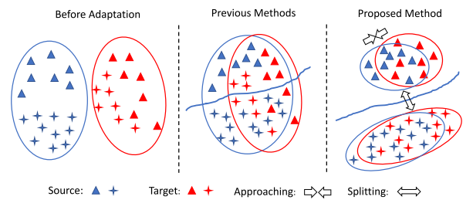
Introduction
In the absence of labeled data from the target domain, Unsupervised Domain Adaptation (UDA) methods have emerged to mitigate the domain shift in data distributions
Class-agnostic adaptation problems :
1. Samples of different classes may be aligned incorrectly
2. The learned decision boundary may gener- alize poorly for the target domain

Slide 4
Introduction
Solution:
Contrastive Adaptation Network (CAN)
In addition to minimizing the cross-entropy loss on labelled source data, CAN alternatively estimates the underlying label hypothesis of target samples through clustering, and adapts the feature representations according to the CDD metric.

Slide 5
Methodology
2.1 Maximum Mean Discrepancy Revisit
2.2 Contrastive Domain Discrepancy
2.3 Contrastive Adaptation Network
2.4 Optimizing CAN

Slide 6



Methodology
Unsupervised domain adaptation (UDA) :
$$S={\{(x}_{1}^{s}{,y}_{1}^{s}),…, {(x}_{Ns}^{s}{,y}_{Ns}^{s})\}$$
$$T={\{x}_{1}^{t},…,x_{Nt}^{t}\}$$
$$Yt∈\{0,1,…,M−1\}$$
Unknown

Slide 7

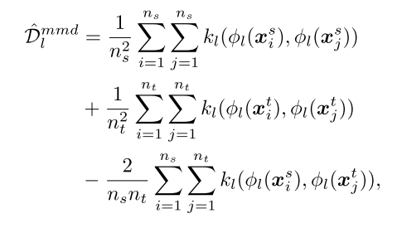
2.1 Maximum Mean Discrepancy Revisit
Where :
Ø_{l}(X) = Outputs of layer l for input x
N_{s} = mini-batch source
N_{t} = mini-batch target
K_{l} = kernel for l-th layer
Notes:
Omniglot images (or x-values for regression), xt, are presented with time-offset labels (or function values), y_{t−1}, to prevent the network from simply mapping the class labels to the output. From episode to episode, the classes to be presented in the episode, their associated labels, and the specific samples are all shuffled.

Slide 8

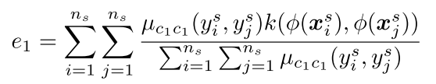

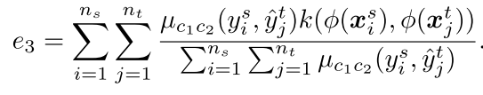
2.2 Contrastive Domain Discrepancy
Measuring the intra-class and inter-class discrepancy across domains.
Where
Notes:
A successful strategy would involve the use of an external memory to store bound sample representation-class label information, which can then be retrieved at a later point for successful classification when a sample from an already-seen class is presented. Specifically, sample data x_{t} from a particular time step should be bound to the appropriate class label y_{t}, which is presented in the subsequent time step. Later, when a sample from this same class is seen, it should retrieve this bound information from the external memory to make a prediction.

Slide 9
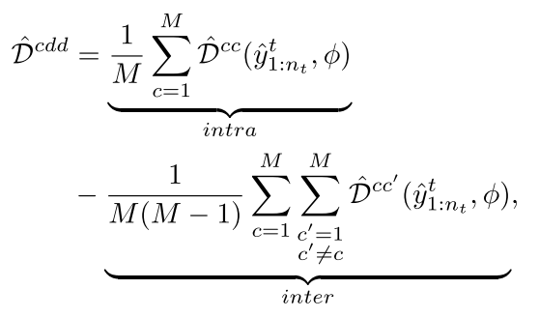
2.2 Contrastive Domain Discrepancy
CDD is calculated as :
Notes:
A successful strategy would involve the use of an external memory to store bound sample representation-class label information, which can then be retrieved at a later point for successful classification when a sample from an already-seen class is presented. Specifically, sample data x_{t} from a particular time step should be bound to the appropriate class label y_{t}, which is presented in the subsequent time step. Later, when a sample from this same class is seen, it should retrieve this bound information from the external memory to make a prediction.

Slide 10

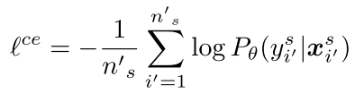
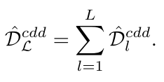
2.3 Contrastive Adaptation Network
Overall objective :
Where :
β = weight of the discrepancy penalty term
y_{s} = ground-truth label of sample x_{s}
P_{θ}(y|x) = predicted probability of label y

Slide 11
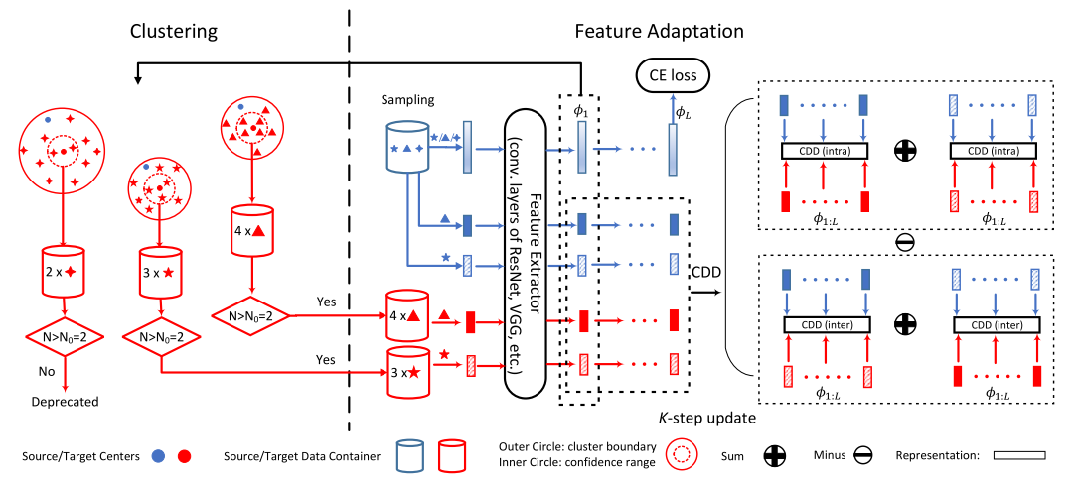
2.4 Optimizing CAN

Slide 12
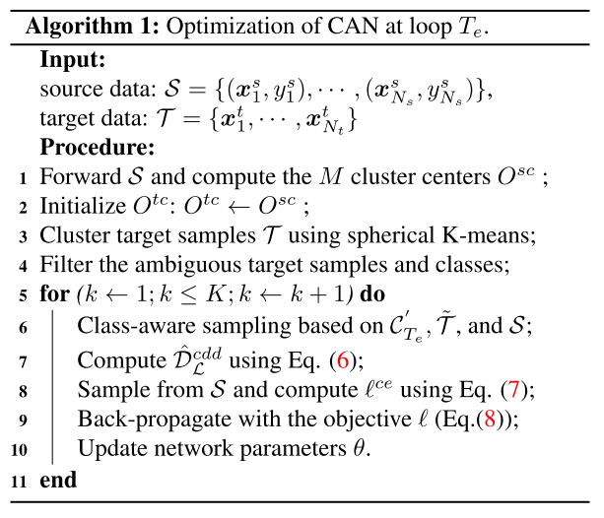
2.4 Optimizing CAN

Slide 13
Experiments
3.1 Setups
3.2 Comparison with the state-of-the-art
3.3 Ablation studies

Slide 14
3.1 Setups
Datasets :
Office-31
4.110 images, 31 classes :
2,817 images → Amazon domain
795 images → Webcam domain
498 images → DSLR domain
VisDA-2017
Synthetic data to real imagery
280k images, 12 categories
The images are split into 3 sets :
training set → 152,397 synthetic images
validation set → 55,388 real-world images,
test set → 72,372 real-world images

Slide 15
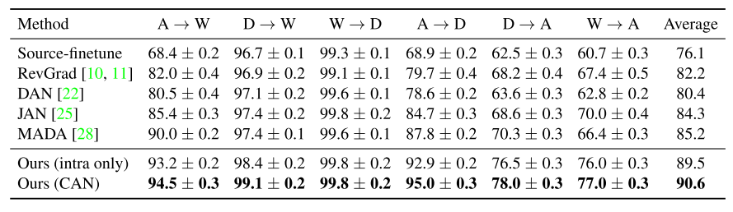
3.2 Comparison with the state-of-the-art

Slide 16
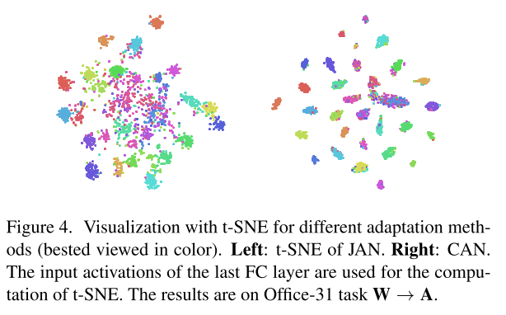
3.2 Comparison with the state-of-the-art

Slide 17
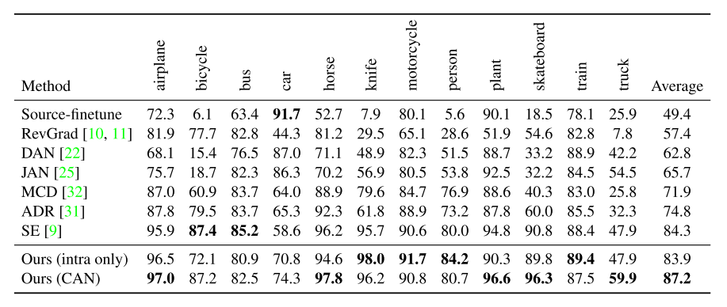
3.2 Comparison with the state-of-the-art

Slide 18
3.3 Ablation studies
Effect of inter-class domain discrepancy
it is impossible to completely eliminate the intra-class domain discrepancy, maximizing the inter-class domain discrepancy may alleviate the possibility of the model overfitting to the source data and benefits the adaptation.

Slide 19
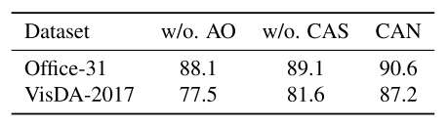
3.3 Ablation studies
Effect of alternative optimization and class-aware Sampling

Slide 20
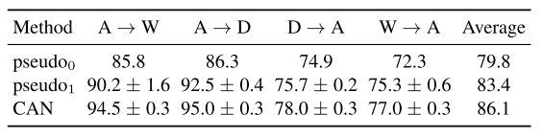
3.3 Ablation studies
Ways of using pseudo target labels

Slide 21
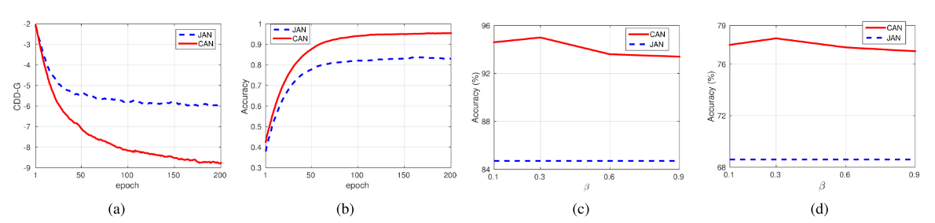
3.3 Ablation studies
CDD value during training

Slide 22
Conclusion
Intra-class and inter-class domain discrepancy are explicitly modelled and optimized through end-to-end mini-batch training
CAN outperforms strong baselines

Slide 23
감사합니다 Thank You

